Slide 1
Introducing the Service Registry
David Loveluck

Slide 2
Vision for Service Registry in 2000
One interconnected web of services
UDDI would be core SOAP standard
Universally linking consumers with servers
Not a sustainable model
UDDI dropped from windows in 2010
UDDI still exists but with few, incompatible implementations

Slide 3
Enterprise Service Bus Architecture
Isolate Consumers from Providers
Consumers
Enterprise Service Bus
Providers

Slide 4
Enterprise Service Bus Architecture
Services Available to Consumers
Consumers
Enterprise Service Bus
Providers

Slide 5
Enterprise Service Bus Architecture
Services Available to the Service Bus
Consumers
Enterprise Service Bus
Providers

Slide 6
Enterprise Service Bus Architecture
User Populations
Internal?
Departmental?
Customers?
Public?

Slide 7
Service Registry
For Services Available to Consumers
Service Discovery
Service Information
Access Control

Slide 8
API Management
Out of scope of this work
Manage thousands of services
Manage thousands of customers
Manage subscription levels
Self service registration

Slide 9
Public Service Registry
Services Available to Consumers

Slide 10
Ensemble Public Service Registry
Directory of services exposed by Ensemble
Directory of services exposed by Ensemble
Search for services and details of the service
Location and URL
Simple values or documents
Descriptions
Service Level agreement
Custom information
REST API
Resource based access
UI for Ensemble administrators

Slide 11
Public Service Registry
Information stored
Name
Domain
Version
Lifecycle Stage (actual property name is just Stage) - Concept, Development, Test, Staging, Live, Deprecated, Defunct
Service Protocol - SOAP, REST, HTTP, File, etc…
Description
Endpoint
Response Style - Sync, Callback, Remote Deposit, None
Topics (as a list)
….

Slide 12
REST API
Consumers can query registry
Nine methods exposed. For example …
GetServices
Path: /services
Returns all services that have been marked as visible and which this particular use is permitted to see (both of these conditions are needed for the other methods as well)
GetServicesByID
Path: /services/id/:name/:domain/:version
Returns the particular services which can be identified by these three properties
GetServicesByProtocols
Path: /services/protocols/:protocols
Returns services whose protocols are among those in the comma-delimited list of specified protocols

Slide 13
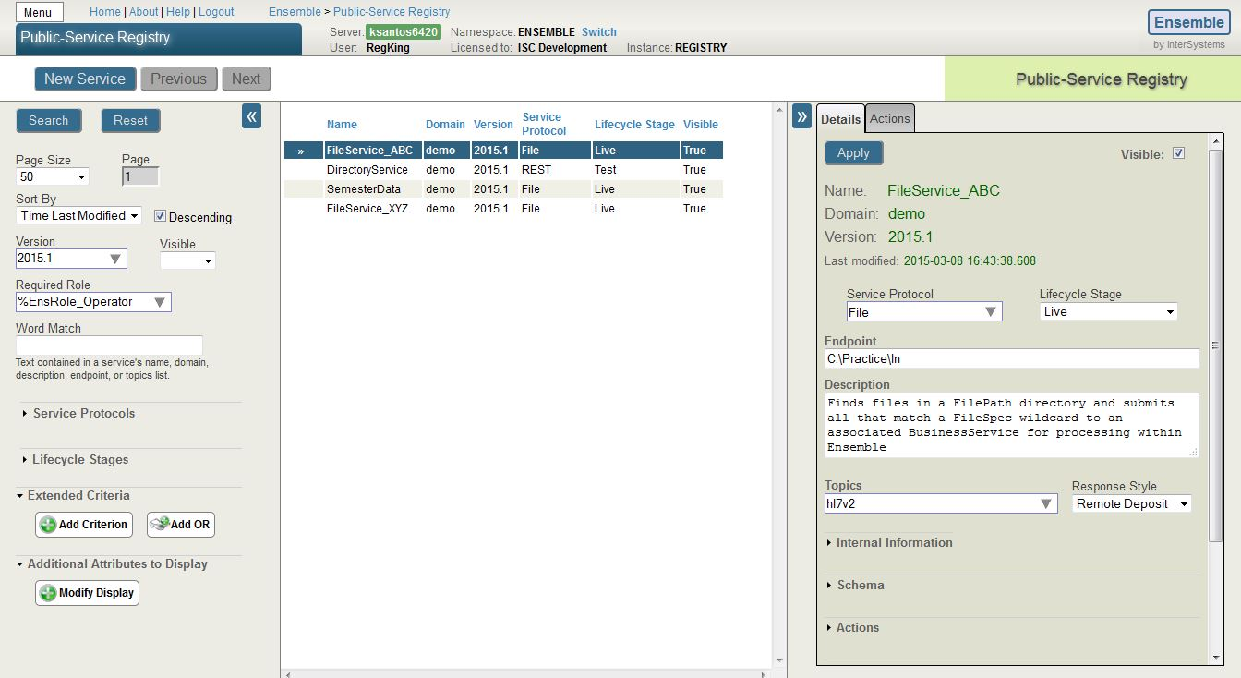
Administrator User Interface
Create, Update, Delete

Slide 14
External Service Registry
Services that can be called from Ensemble

Slide 15
Enterprise Service Bus Architecture
Services Available to Ensemble
Consumers
Enterprise Service Bus
Providers

Slide 16
External Registry
Focus on the services called from Ensemble
Name is ‘difficult’ and may change
Analogous to HealthShare Service Registry
Similar Set of data stored to Public Service Registry
No API for querying registry
Only accessible inside Ensemble
Used by Business Operations

Slide 17
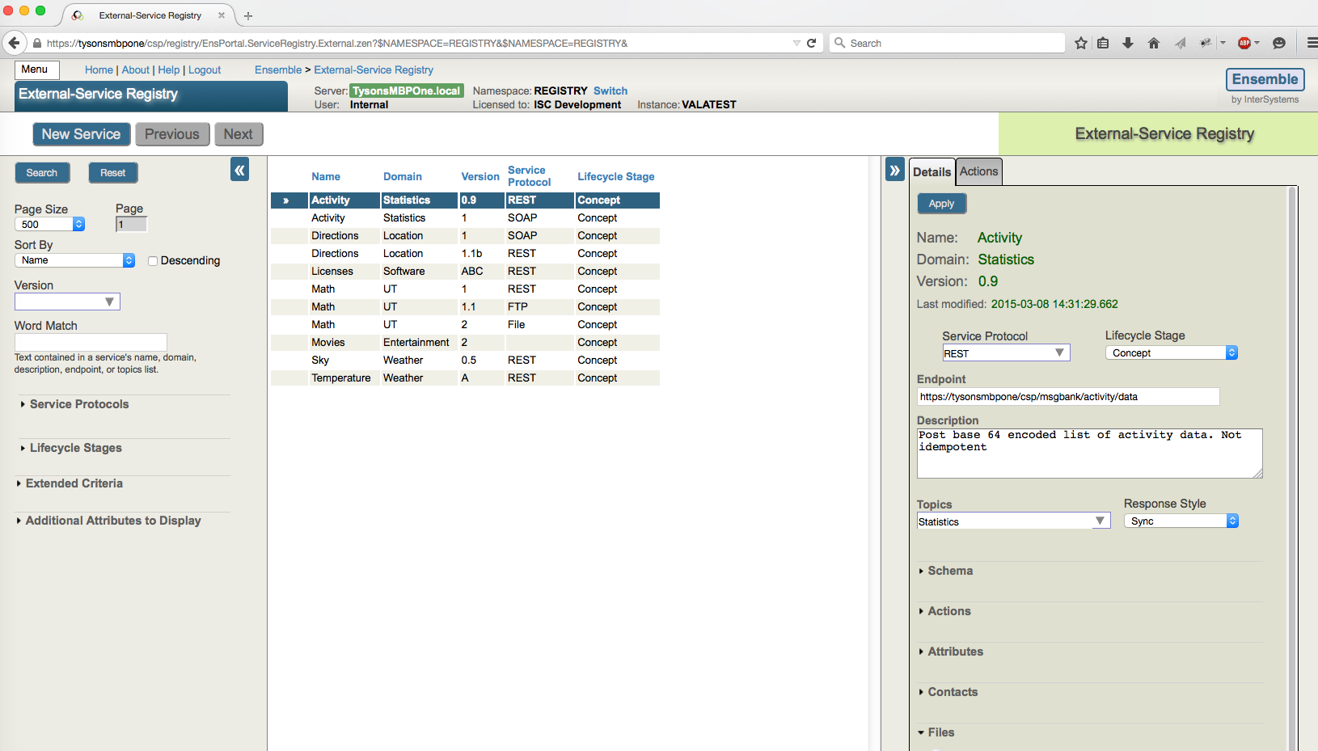
External Service Registry
Administrator User Interface

Slide 18
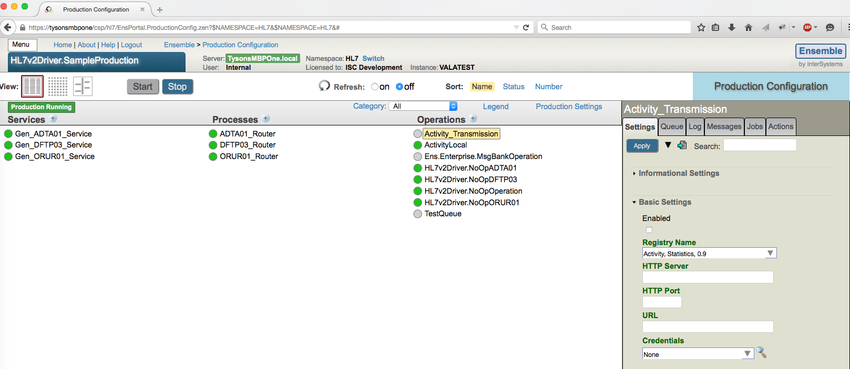
External Service Registry
Configuration Screens

Slide 19
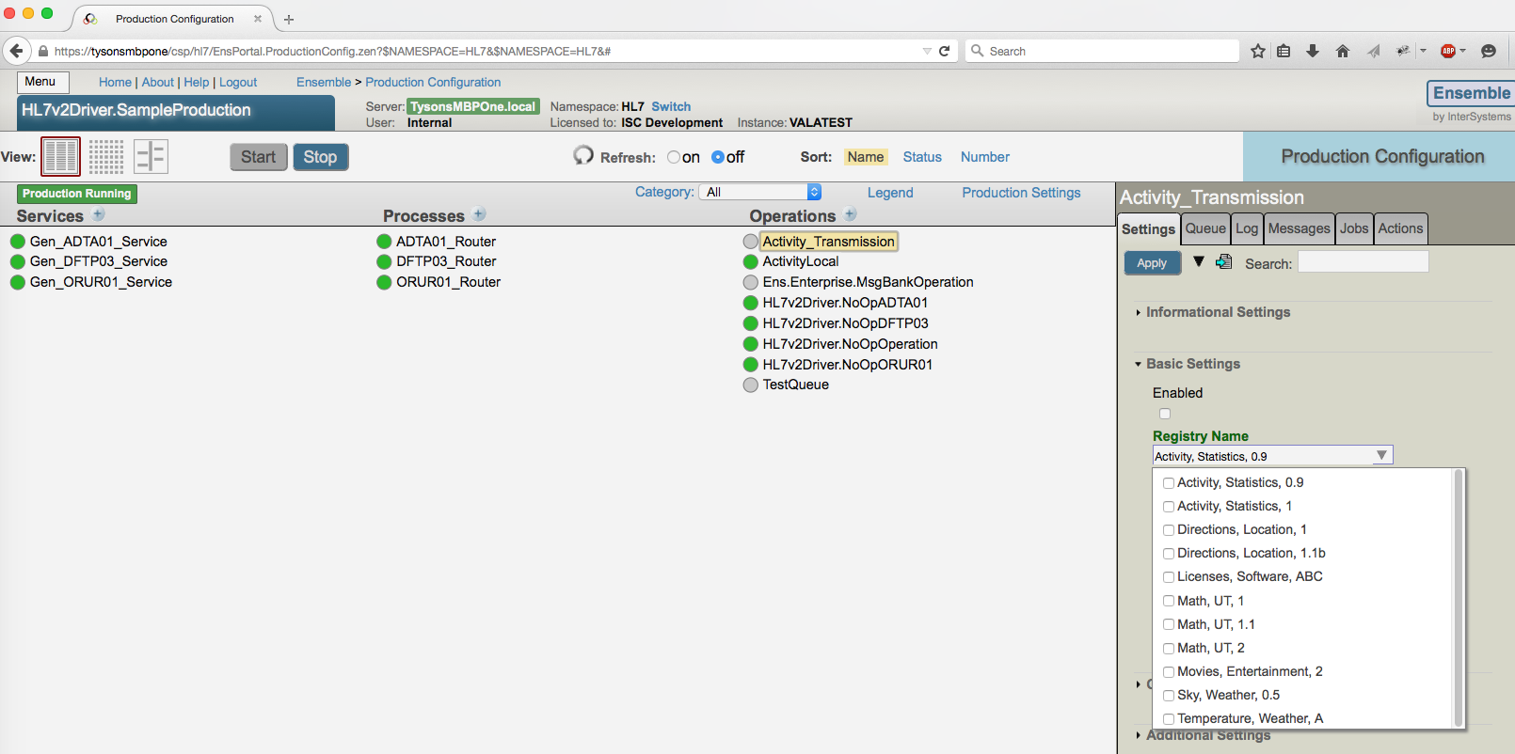
External Service Registry
Configuration Screens

Slide 20
Questions??

